Slide 1

Files and Paths
RALPH BUNCHE SUMMER INSTITUTE 2023
DUKE UNIVERSITY
METHODS LAB
MATEO VILLAMIZAR-CHAPARRO

Slide 2
Types of R Files that can be open in RStudio
R is a very dynamic program and can produce a lot of files. For the sake of this lab we are going to be focusing on three.
R data file .Rda or .Rds
R Script file .R
R markdown .Rmd

Slide 3
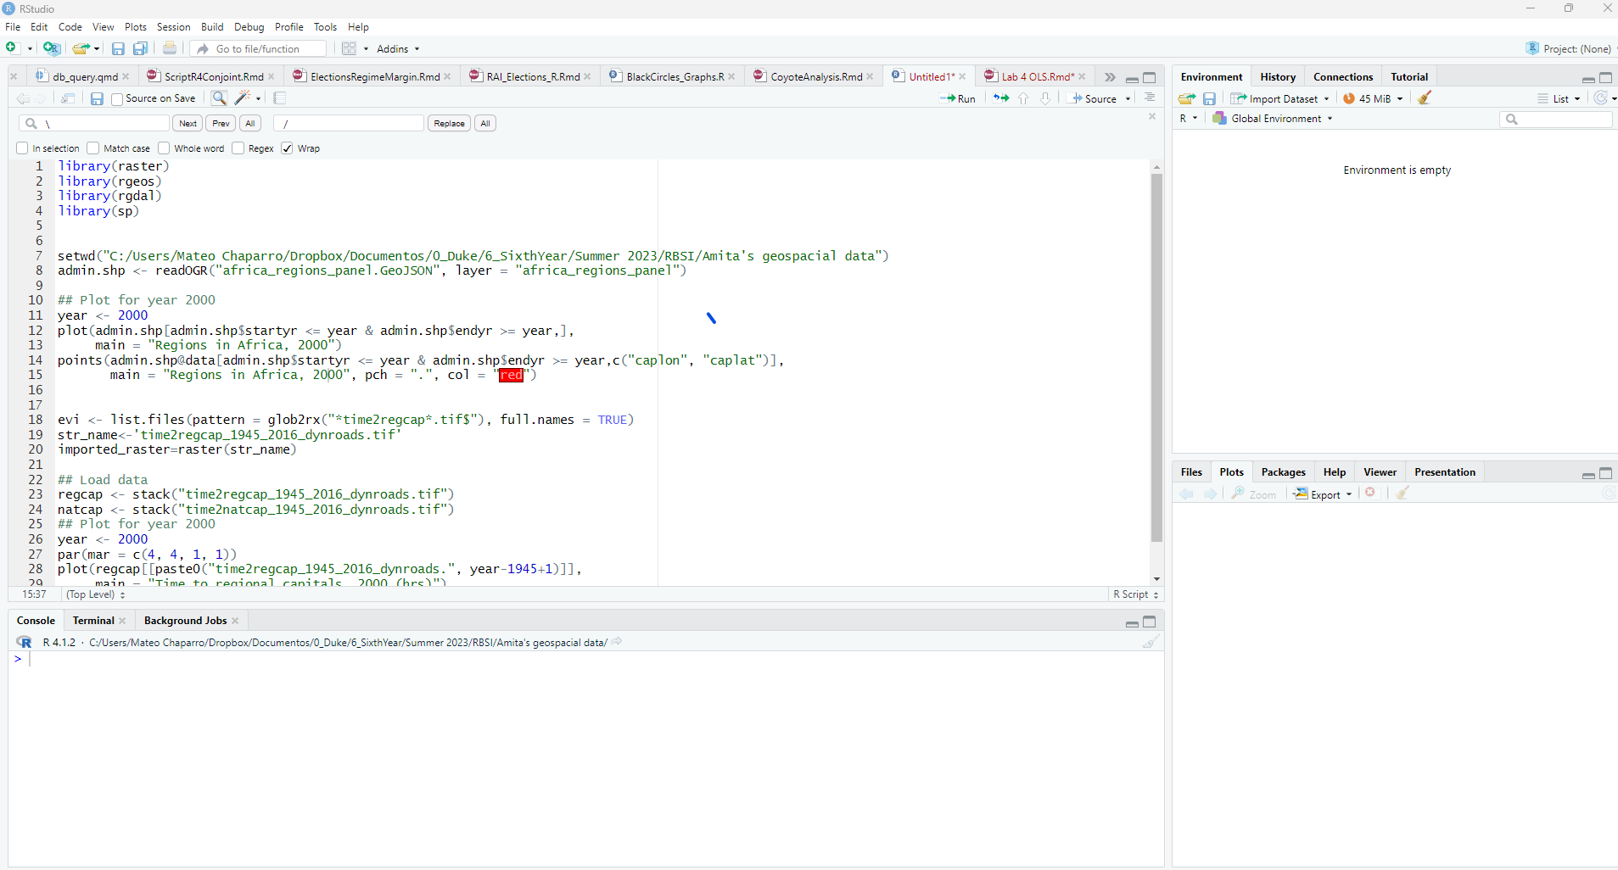
R scripts .R

Slide 4
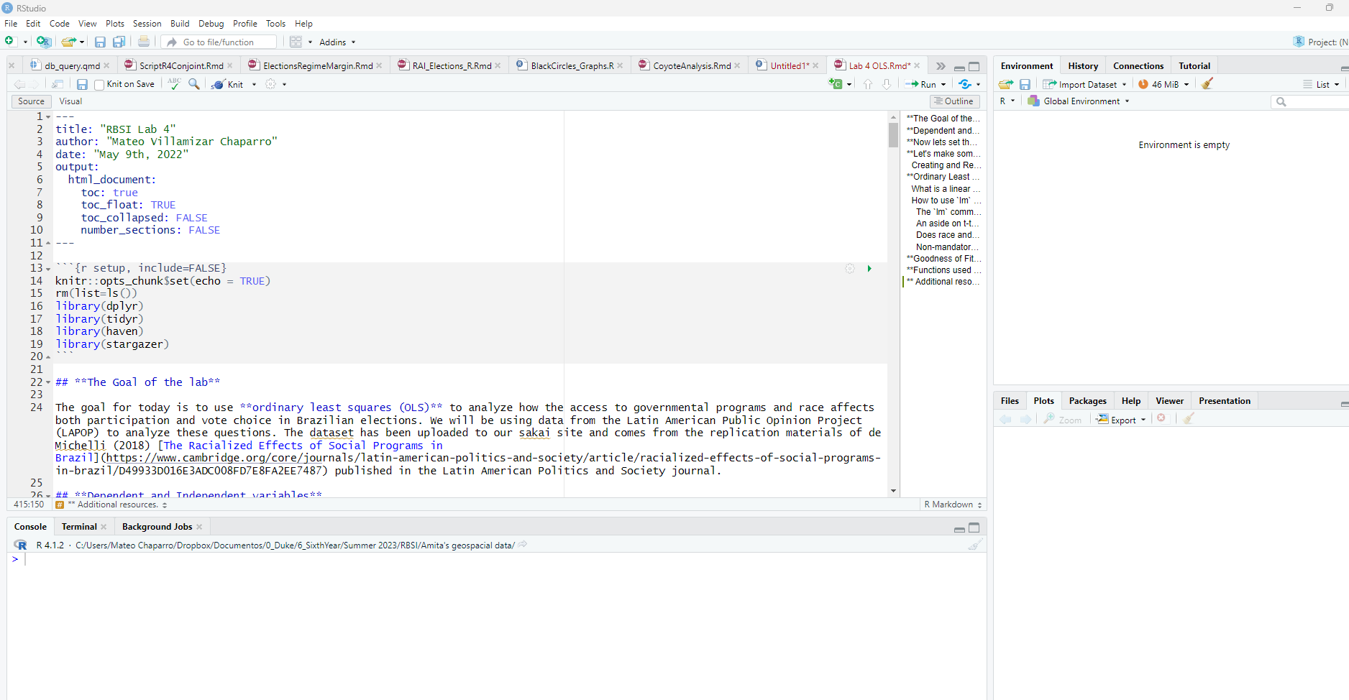
R Markdown .Rmd

Slide 5
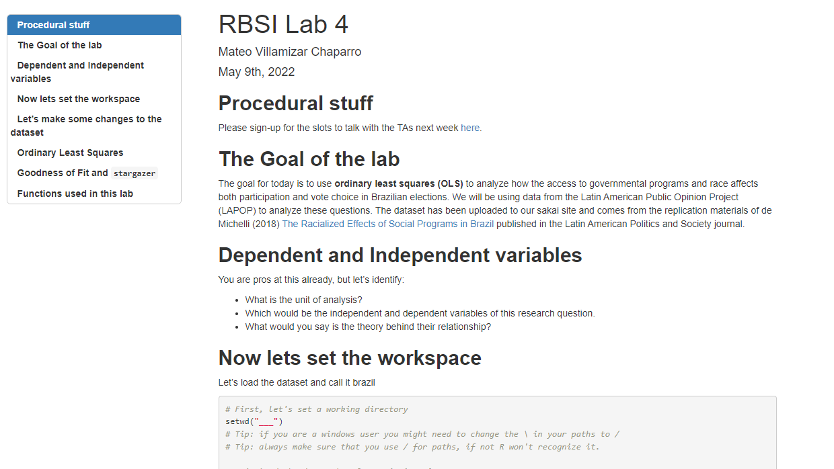

Slide 6
Types of Data Files and how to import them into R
.Rda or .Rds use load()
.dta use haven::read_stata() or haven:read_dta() [Some newer versions of stata might need different packages]
.csv use read.csv()
.sav use foreign::read.spss() or haven::read_sav()
.xls or .xlsx use readxl::read_excel()

Slide 7

Replicability is important
This is why having an organized R script is very important. People, should be able to run your script and get exactly the same results!!
A key feature of replicability is organization. It is important to have your files organized in folders OTHER than the downloads folder.

Slide 8
Setting working directories (setwd())
You will always want to have your working directory set up in your R replication file. This way, R can easily access the files in that folder without you having to manually reach them. Usually, for replication purposes avoid any manual steps in your code. Everything should be running smoothly.

Slide 9
Exercise 1
Create a folder in your computer (or virtual machine) and upload the files for todays lab.
Open the .Rmd file and set your working directory.
You can get the file paths:
Rstudio online: click on the folder > More > Copy folder path to clipboard
Mac: click Finder icon > View > Show Path Bar
Windows: just click on the top of your window or doueble click “copy as path”

